Slide 1
Unit V Security in the Cloud

Slide 2
Security Overview:
Security in the cloud is a multifaceted area that encompasses various layers and considerations due to the distributed and shared nature of cloud computing. Here's an overview of key aspects of security in the cloud:
1.Data Security:
Encryption: Ensuring data encryption both in transit and at rest to prevent unauthorized access.
Access Controls: Implementing strong identity and access management (IAM) to control who can access specific resources and data.
Data Loss Prevention (DLP): Employing measures to prevent accidental or malicious data leaks or loss.

Slide 3
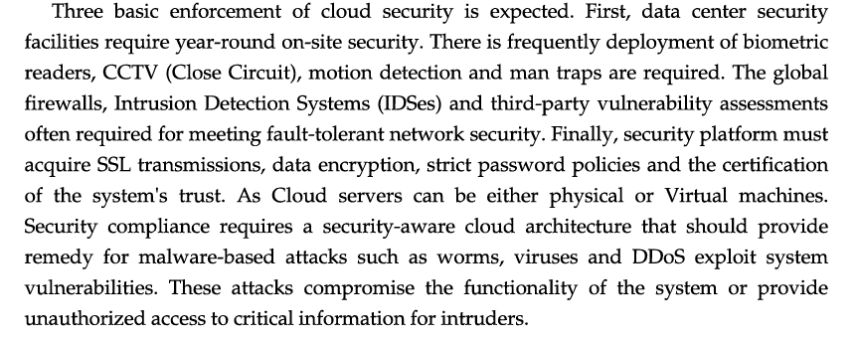

Slide 4
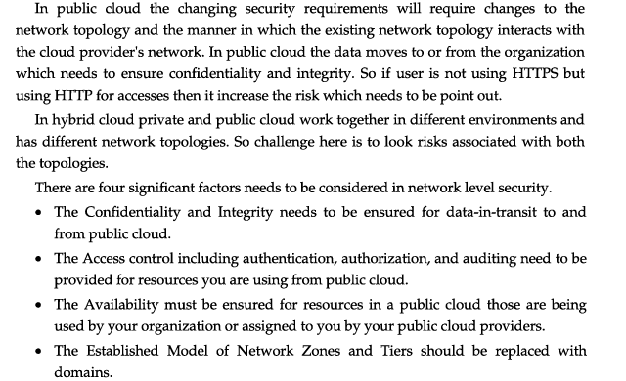
2.Network Security:
Firewalls and Network Segmentation: Setting up firewalls and segmenting networks to control and monitor traffic flow between different components.
DDoS Mitigation: Implementing measures to mitigate Distributed Denial of Service (DDoS) attacks and ensure continuous availability.

Slide 5
3.Identity and Access Management (IAM):
Authentication and Authorization: Verifying and granting appropriate access rights to users and resources.
Authentication is the process of verifying a user's identity, while authorization is the process of granting access.
Multi-Factor Authentication (MFA): Adding extra layers of authentication beyond passwords to enhance security.

Slide 6
4.Compliance and Governance:
Regulatory Compliance: Ensuring adherence to industry-specific regulations and compliance standards (e.g., GDPR, HIPAA) based on the type of data being handled.
Auditing and Logging: Maintaining detailed logs and conducting regular audits to track activities and identify potential security issues.
5.Incident Response and Management:
Security Monitoring: Continuous monitoring of systems and networks to detect and respond to security threats promptly.
Response Planning: Developing plans and protocols to respond effectively to security incidents, including containment, eradication, and recovery.

Slide 7
6.Physical Security:
Data Center Security: Ensuring physical security measures at data centers, including access controls, surveillance, and environmental controls.
7.Shared Responsibility Model:
Understanding the shared responsibility model between the cloud service provider (CSP) and the customer. While the CSP manages the infrastructure, customers are responsible for securing their applications, data, and configurations.
8.Security Best Practices:
Regular Updates and Patch Management: Keeping systems and software up-to-date with the latest security patches.
Security Training and Awareness: Educating users and teams about security best practices and potential threats.

Slide 8
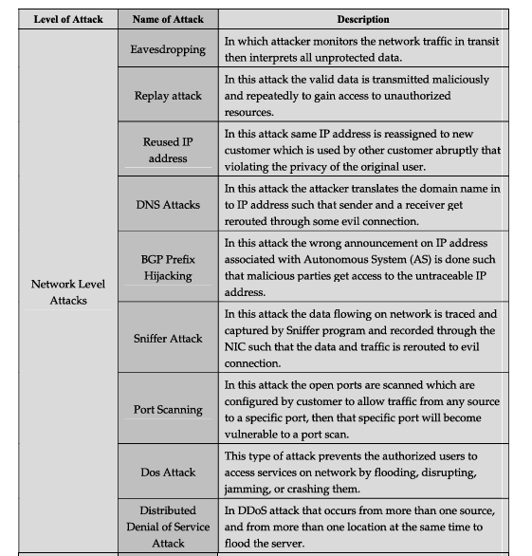
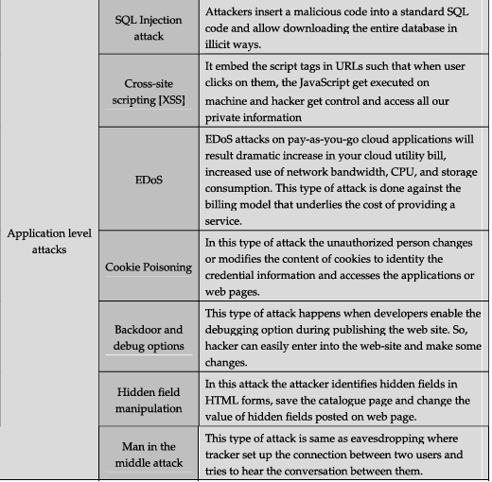

Slide 9
Cloud Security Challenges and Risks
Cloud computing offers numerous benefits, but it also introduces specific security challenges and risks that organizations need to address. Some of the prominent challenges and risks include:
1.Data Breaches:
Unauthorized Access: Weak access controls or misconfigured permissions might lead to unauthorized access to sensitive data.
Data Loss: Data stored in the cloud can be susceptible to accidental deletion, corruption, or malicious attacks leading to data loss.
2.Insecure Interfaces and APIs:
Vulnerabilities in Interfaces: Poorly designed or insecure application interfaces and APIs can be exploited, leading to unauthorized access or data breaches.

Slide 10
3.Insufficient Identity, Credential, and Access Management:
Weak Authentication: Inadequate authentication methods or compromised credentials can result in unauthorized access to cloud services and data.
Improper Access Controls: Misconfiguration of access controls might result in unintended exposure of sensitive data.
4.Shared Technology Issues:
Shared Resources: Multi-tenancy in the cloud can pose risks if security controls between tenants are inadequate, potentially leading to data leaks or cross-tenant attacks.
Virtual Machine (VM) Security: Vulnerabilities in hypervisors or VM isolation weaknesses might allow attackers to gain access to other VMs on the same host.

Slide 11
5.Data Loss and Leakage:
Insecure Data Handling: Inadequate encryption, improper data transfer, or weak data management practices can lead to data leaks or exposure.
Lack of Visibility and Control: Limited visibility and control over data once it's in the cloud might increase the risk of data loss or leakage.
6.Compliance and Legal Risks:
Regulatory Compliance: Staying compliant with various regulatory standards and industry-specific requirements while operating in the cloud can be challenging.
Legal Issues: Data sovereignty, jurisdictional issues, and legal uncertainties across different regions can complicate compliance efforts.

Slide 12
7.Insecure Configuration and Poor Security Practices:
Misconfiguration of Cloud Services: Incorrectly configured cloud services can create security gaps or expose sensitive information.
Lack of Security Best Practices: Failure to follow security best practices, inadequate employee training, or neglecting security updates can increase vulnerability.
8.Cloud Service Provider (CSP) Risks:
Vendor Lock-in: Dependence on a single CSP might limit flexibility and pose risks during service disruptions or changes.
CSP Security Measures: Relying on the CSP's security measures without understanding their limitations or without proper oversight can lead to gaps in security.

Slide 13
Software as a service
Software as a Service (SaaS) is a cloud-based software distribution model where applications are hosted by a third-party provider and made available to users over the internet.
Here's an overview of SaaS:
1.Accessibility and Convenience:
•Users access the software through a web browser or a dedicated application without needing to install or maintain the software locally.
•It offers accessibility from any device with an internet connection, promoting remote work and flexibility.

Slide 14
2.Subscription-Based Model:
SaaS operates on a subscription basis, typically with monthly or annual payment plans, allowing scalability and predictable costs.
Users pay for access to the software rather than purchasing and maintaining licenses.
3.Managed by Service Providers:
The SaaS provider manages maintenance, updates, security, and infrastructure, relieving users of the burden of software maintenance.
It allows for rapid deployment of updates and new features without user intervention.

Slide 15
4.Scalability and Customization:
SaaS applications often offer scalability, allowing users to adjust their usage levels based on demand.
Customization options might be available to tailor the software to some extent to fit specific business needs.
5.Multi-Tenancy Architecture:
SaaS applications are typically built on a multi-tenant architecture, where multiple users or "tenants" share the same instance of the software while maintaining their data isolation and security.

Slide 16
6.Examples of SaaS:
Productivity Tools: Google Workspace (formerly G Suite), Microsoft 365.
Customer Relationship Management (CRM): Salesforce, HubSpot.
Collaboration and Communication: Slack, Zoom.
Human Resource Management: Workday, BambooHR.
7.Security Considerations:
SaaS providers are responsible for ensuring the security of their platforms, including data encryption, access controls, and compliance with industry standards.
Users must also implement proper security measures, such as strong authentication and access control, to protect their data.

Slide 17
8.Challenges:
Data Security Concerns: Storing sensitive data off-site raises security concerns, necessitating trust in the provider's security measures.
Dependency on Providers: Users rely on the service provider's availability and performance, which can impact operations if there are service disruptions.
SaaS has become a popular choice for businesses due to its cost-effectiveness, flexibility, and ease of use. However, while it offers numerous benefits, careful consideration of security, reliability, and compatibility with existing systems is crucial before adopting a SaaS solution.

Slide 18
Risk Management
Risk management encompasses the identification, analysis, and response to risk factors that form part of the life of a business.
Effective risk management means attempting to control, as much as possible, future outcomes by acting proactively rather than reactively.
Therefore, effective risk management offers the potential to reduce both the possibility of a risk occurring and its potential impact.

Slide 19
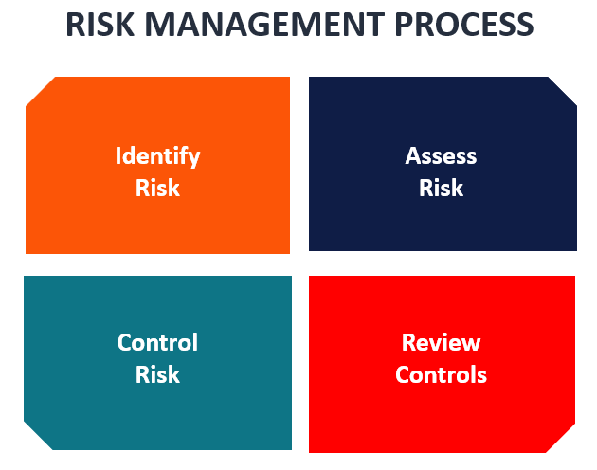

Slide 20
Risk Management Structures:
Risk management structures are tailored to do more than just point out existing risks. A good risk management structure should also calculate the uncertainties and predict their influence on a business.
Consequently, the result is a choice between accepting risks or rejecting them. Acceptance or rejection of risks is dependent on the tolerance levels that a business has already defined for itself.
If a business sets up risk management as a disciplined and continuous process for the purpose of identifying and resolving risks, then the risk management structures can be used to support other risk mitigation systems. They include planning, organization, cost control, and budgeting. In such a case, the business will not usually experience many surprises, because the focus is on proactive risk management.

Slide 21
Response to Risks
Response to risks usually takes one of the following forms:
Avoidance: A business strives to eliminate a particular risk by getting rid of its cause.
Mitigation: Decreasing the projected financial value associated with a risk by lowering the possibility of the occurrence of the risk.
Acceptance: In some cases, a business may be forced to accept a risk. This option is possible if a business entity develops contingencies to mitigate the impact of the risk, should it occur.
When creating contingencies, a business needs to engage in a problem-solving approach. The result is a well-detailed plan that can be executed as soon as the need arises. Such a plan will enable a business organization to handle barriers or blockage to its success because it can deal with risks as soon as they arise.

Slide 22
Importance of Risk Management
Risk management is an important process because it empowers a business with the necessary tools so that it can adequately identify and deal with potential risks. Once a risk has been identified, it is then easy to mitigate it. In addition, risk management provides a business with a basis upon which it can undertake sound decision-making.
For a business, assessment and management of risks is the best way to prepare for eventualities that may come in the way of progress and growth. When a business evaluates its plan for handling potential threats and then develops structures to address them, it improves its odds of becoming a successful entity.

Slide 23
Risk Analysis Process
Risk analysis is a qualitative problem-solving approach that uses various tools of assessment to work out and rank risks for the purpose of assessing and resolving them. Here is the risk analysis process:
1. Identify existing risks
Risk identification mainly involves brainstorming. A business gathers its employees together so that they can review all the various sources of risk. The next step is to arrange all the identified risks in order of priority. Because it is not possible to mitigate all existing risks, prioritization ensures that those risks that can affect a business significantly are dealt with more urgently.

Slide 24
2. Assess the risks
In many cases, problem resolution involves identifying the problem and then finding an appropriate solution. However, prior to figuring out how best to handle risks, a business should locate the cause of the risks by asking the question, “What caused such a risk and how could it influence the business?”
3. Develop an appropriate response
Once a business entity is set on assessing likely remedies to mitigate identified risks and prevent their recurrence, it needs to ask the following questions: What measures can be taken to prevent the identified risk from recurring? In addition, what is the best thing to do if it does recur?
4. Develop preventive mechanisms for identified risks
Here, the ideas that were found to be useful in mitigating risks are developed into a number of tasks and then into contingency plans that can be deployed in the future. If risks occur, the plans can be put to action.

Slide 25
Security Monitoring
Security monitoring involves the continuous observation, collection, and analysis of security-related data to detect and respond to potential threats or anomalies within an organization's systems and networks.
Here's an overview of key aspects of security monitoring:
1.Types of Security Monitoring:
•Network Monitoring: Tracking network traffic to identify suspicious activities, unauthorized access, or potential vulnerabilities.
•Endpoint Monitoring: Monitoring individual devices (computers, servers, mobile devices) for signs of malware, unusual behavior, or security policy violations.
•Log Monitoring: Analyzing logs generated by various systems and applications to detect security incidents or abnormal patterns.
•Cloud Security Monitoring: Monitoring cloud infrastructure, services, and applications to ensure compliance and detect potential security issues.

Slide 26
Introduction to Security Architecture
Security architecture is defined as the architectural design that includes all the threats and potential risks that can be present in the environment or that particular scenario.
This also includes the security controls and the use of security controls. For the security architecture, the proper documentation is done that includes all the security specifications and all detailed information about the architecture.
The organization uses for its system, and it is mainly used because the architecture is affordable and cost-effective and can be used easily by the organization.

Slide 27
Security Architecture with Diagram
This is defined as the part of enterprise architecture that is particularly designed for addressing the information system and fulfilling the security requirements of the organization.
The system architecture system has a role that meets the security requirements and also helps to protect the company’s operating environment.
It is beneficial for the company as it includes other activities like risk management activities that require continuous improvement, and security architecture helps to meet the organization requirements. It defines proper policies, rules, and regulations that need to be reinforced in the organization and provides proper information about them.

Slide 28
The architecture is also used for allocating the controls for technical security so that the information system of the organization can be maintained properly.
Some companies offer managed IT security services in Houston by a team of seasoned professionals for this very reason.
As the same can be followed in a whole organization, it helps to define common regulations and standards for every employee so that everyone can follow the rules and maintain data integrity and security in the organization.

Slide 29
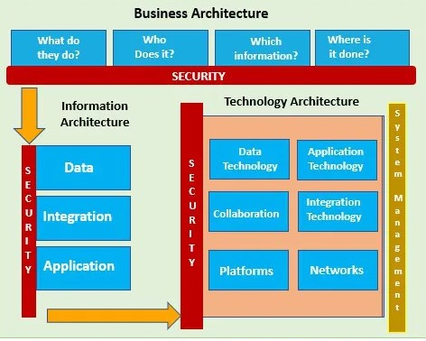

Slide 30
Components of Security Architecture
For making the security architecture important, there are certain components that are involved in the design. The components are people, process and the tools.
All these components combined help to protect the organization’s assets. After defining the components, the next step is to make the policy and the reinforcement technique for the policies.
After the other important steps are the method procedural for the implementation of security architecture and how the architecture will get enforced. By this, the overall design and architecture are designed for the organization that will protect them throughout their business operations

Slide 31
For a proper security architecture, some of the components are briefly discussed:
1. Guidance
The policies and procedures that act as the guidance should be design and implement properly. The policies should include the documentation that includes the objectives and goals for designing the architecture, standards, policies, rules and regulations for the organization, identification of scope and function, identification of other security policies.
2. Identity Management
It is the type of system that include the organization processes, technologies and policies that directly help users to gain access to the online applications and other network resources. For the organization, the proper responsibilities and roles need to be clearly stated, and individual tasks need to be designed for the employees.

Slide 32
3. Inclusion & Exclusion
The other components are the inclusion and exclusion that include the security of elements of the organization in which company resources are protected. The company resources include web resources, e-mail servers, private HR data and other reporting system information. The access should be grant to authorized users only so that the privacy and integrity can be maintained in the organization.
4. Access and Border Control
The organization should develop an architecture that is able to control the access to the business resources and can use the layer system for providing access to the company employees. Only authorized users should gain complete access to the system, and the rest should be provided with limited access of the system.

Slide 33
5. Validation of Architecture
As the technology advances, the company need to renew the policies and laws as per the changes, and continuous effort is needed by the organization in this change. For that, the continuous monitoring is required, and according to that, proper changes can be made in the architecture.
6. Training
As for the organization, to maintain the privacy and integrity, the security architecture system is very important. AS there is a continuous change in the system, it becomes important that the employee should know about the changes and proper training is given to them so that they can use the system and protect the company assets and elements.
7. Technology
To reinforce the security architecture, the software and hardware used for making the architecture become very crucial for the organization. Because of continuous change in technology, there is a requirement of continuous change in the system so that the system can be up to date and help to make the system secure and private.

Slide 34
Benefits of Using the Security Architecture
Some of the benefits are mentioned below.
Help to protect the important company assets from the outside and provide security to the important resources to the organization. The architecture provides the limited access to the user so that the confidential data can be kept secure and safe.
The architecture defines the common policies and standards that can be used by the every employee of the company and also define common rules so that no one face any difficulty to use the system. It helps the organization to reach their goal and easily conduct their business operations smoothly.
The other benefit is risk management activities covered by the architecture as the risk management activity requires continuous assistance and also need continuous improvement, the security architecture act as a better solution for them.

Slide 35
Application Security
What is Application Security?
All tasks that introduce a secure software development life cycle to development teams are included in application security shortly known as AppSec. Its ultimate purpose is to improve security practices and, as a result, detect, repair, and, ideally, avoid security flaws in applications. It covers the entire application life cycle, including requirements analysis, design, implementation, testing, and maintenance.

Slide 36
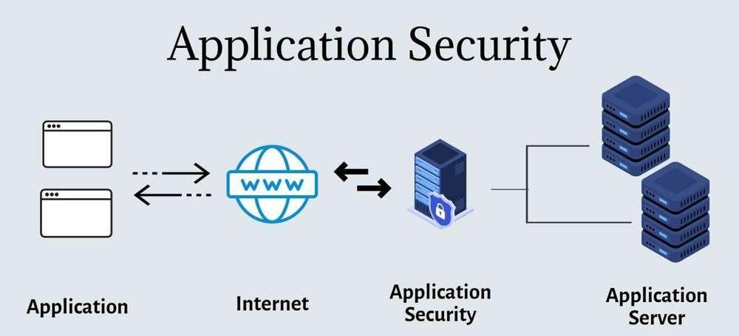

Slide 37
Hardware, software, and procedures that identify and mitigate security vulnerabilities may be included in application security.
Hardware application security refers to a router that stops anyone from viewing a computer's IP address over the Internet.
However, application-level security controls, such as an application firewall that rigorously limits what actions are allowed and banned, are often integrated into the software.
An application security routine that includes protocols such as regular testing is an example of a procedure.

Slide 38
Types of Application Security
Authentication, authorization, encryption, logging, and application security testing are all examples of application security features. Developers can also use code to reduce security flaws in applications.
Authentication
When developers include protocols in an application to ensure that only authorized users have access to it. Authentication procedures verify that the user is who they claim to be. When logging into an application, this can be performed by requiring the user to supply a user name and password. Multi-factor authentication necessitates the use of multiple forms of authentication, such as something you know (a password), something you have (a mobile device), and something you are (a biometric).

Slide 39
Authorization
A user may be authorized to access and use the application after being authenticated. By comparing the user's identification to a list of authorized users, the system may verify that the user has permission to access the application. In order for the application to match only validated user credentials to the approved user list, authentication must take place before authorization.
Encryption
Other security measures can safeguard sensitive data from being seen or utilized by a cybercriminal after a user has been verified and is using the application. Traffic containing sensitive data that flows between the end-user and the cloud in cloud-based applications can be encrypted to keep the data safe.
Logging
If a security breach occurs in an application, logging can assist in determining who gained access to the data and how they did so. Application log files keep track of which parts of the application have been accessed and by whom.

Slide 40
Data Security:
Data security is defined as the set of practices to ensure the protection of data from unauthorized access, theft, or deletion throughout its lifecycle.
It is a crucial practice to ensure the integrity, reliability, and availability of data only to authorized users.
As a concept, it encompasses every aspect of data security, such as software application security, administrative controls, and access controls, by adopting specific policies and procedures.
It also involves the development and use of tools and technologies to enhance the visibility of data used within an organization or business.

Slide 41
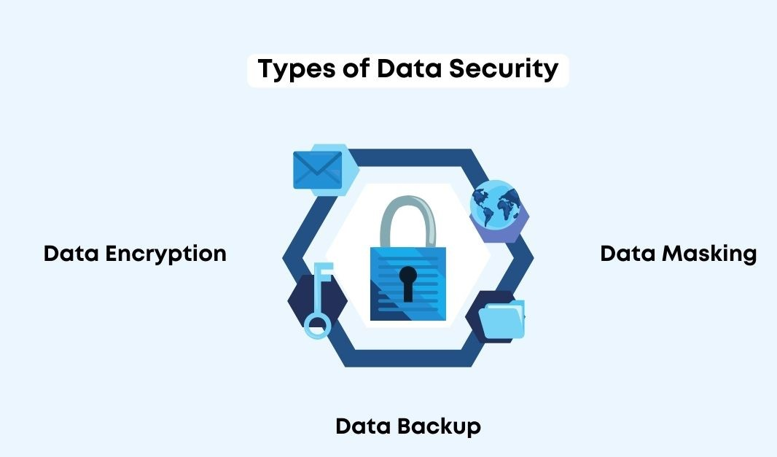
The Main Types of Data Security:
As data comes in various forms, it needs to be treated differently based on its nature.
For an organization to achieve complete data security, it needs to know what data it has, record it, and classify it to facilitate easier management, storage, and security.

Slide 42
The main types of data security include:
Data Encryption
Data encryption is the process of converting readable text with ordinary characters into an unreadable form using an encryption algorithm.
If encrypted data is stolen, it cannot be read or decrypted without the relevant encryption key, serving as a significant line of defense for data security.
Data Masking
Data masking involves hiding data to make it unreadable.
It creates fake versions of a company's data by modifying confidential information and sensitive data collected about customers.
Data Backup
Data backup involves creating copies of files and databases in a secondary location.
In case the primary data is stolen or accidentally destroyed, data backups serve to restore the lost data.

Slide 43
Virtual Machine Security
1. Introduction to VM Security
Virtual machines (VMs) enable multiple OS instances on a single physical machine.
Security ensures the integrity, confidentiality, and availability of VM resources.
2. Key Security Challenges
Hypervisor vulnerabilities: The hypervisor acts as the base of VM management; exploits can compromise all VMs.
VM isolation: Improper isolation can lead to cross-VM attacks.
Snapshot risks: Stale snapshots may expose outdated and unpatched data.
VM sprawl: Unmanaged VMs can create security blind spots.

Slide 44
VM Security Practices
Access Control:
Role-based access control (RBAC) for administrators.
Use strong, multi-factor authentication.
Network Security:
Configure firewalls for VM traffic.
Isolate VMs using virtual LANs (VLANs).
Data Protection:
Encrypt VM disks and network communication.
Secure snapshots and backups.

Slide 45
4. Securing the Hypervisor
Use trusted hypervisor platforms (e.g., VMware ESXi, Hyper-V).
Regularly patch and update the hypervisor.
Limit access to the hypervisor console.
5. Monitoring and Incident Response
Use VM-specific monitoring tools to detect anomalies.
Maintain audit logs for administrative and user activities.
Implement an incident response plan for VM environments.

Slide 46
Identity management and access control
Identity management and access control are fundamental components of security, ensuring that the right individuals have appropriate access to resources while preventing unauthorized access. Here's an overview:
1. Identity Management:
Authentication: Verifying the identity of users or entities accessing systems. This includes various methods like passwords, biometrics, multi-factor authentication (MFA), and certificate-based authentication.
User Provisioning and De-provisioning: Managing user accounts, including creating, updating, and removing access as needed based on roles, job changes, or departures.
Single Sign-On (SSO): Allowing users to access multiple applications with a single set of login credentials, enhancing user convenience while maintaining security.

Slide 47
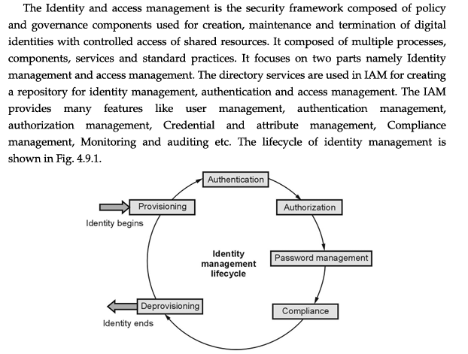

Slide 48
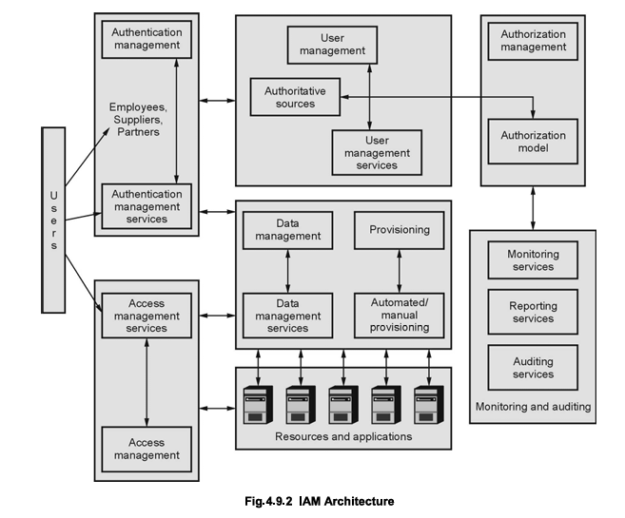

Slide 49
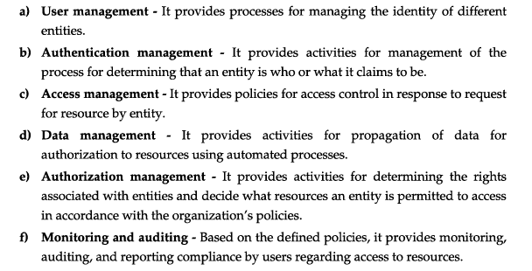
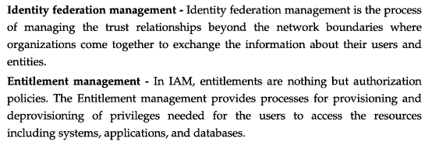
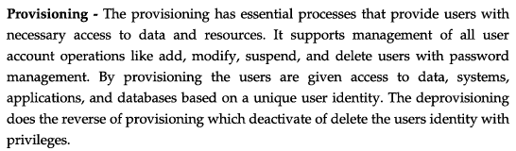

Slide 50
2. Access Control:
Role-Based Access Control (RBAC): Assigning permissions based on predefined roles within an organization. Users are granted access based on their roles, simplifying access management.
Attribute-Based Access Control (ABAC): Granting access based on specific attributes, such as user attributes, environment conditions, or resource attributes.
Least Privilege Principle: Providing users with only the minimum level of access necessary to perform their job functions, minimizing potential damage in case of a security breach.

Slide 51
Autonomic Security:
Autonomic Security Operations is a combination of philosophies, practices, and tools that improve an organization's ability to withstand security attacks through an adaptive, agile, and highly automated approach to threat management.
It involves designing and implementing security measures that can detect, react to, and adapt against threats or vulnerabilities autonomously, resembling self-regulating and self-healing systems. Here are key aspects of autonomic security:
1. Self-Configuration:
•Automated Configuration: Systems can automatically configure security settings and policies based on predefined rules, security best practices, and contextual awareness.
2. Self-Healing:
•Automated Responses: Systems can identify security breaches or anomalies and take corrective actions autonomously, such as isolating affected areas, restoring configurations, or blocking suspicious activities.

Slide 52
3. Self-Optimization:
•Adaptive Controls: Systems can adapt security measures dynamically based on changing environments, threats, or usage patterns. This involves adjusting security protocols, access controls, and configurations to optimize security.
4. Self-Protection:
•Predictive Measures: Employing predictive analytics or AI/ML algorithms to anticipate potential security threats and proactively implement preventive measures before an attack occurs.
5. Self-Awareness:
•Continuous Monitoring: Implementing real-time monitoring and analysis of system behaviors and security events to maintain awareness of the system's state and detect deviations or irregularities.

